Slide 1
Java Data Access (JDBC)
Università di Modena e Reggio Emilia
Prof. Nicola Bicocchi (nicola.bicocchi@unimore.it)

Slide 2
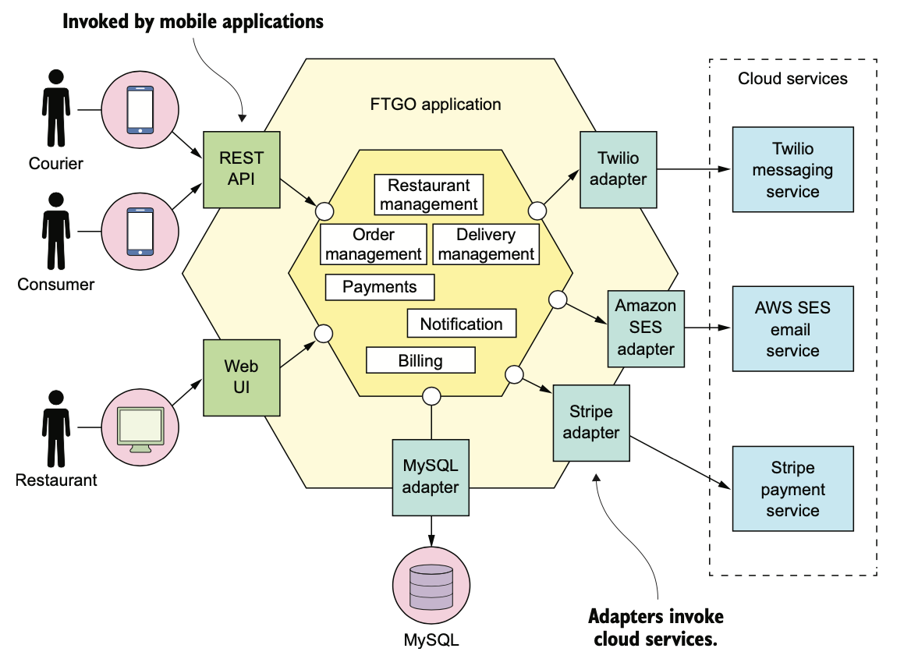
Software Design

Slide 3
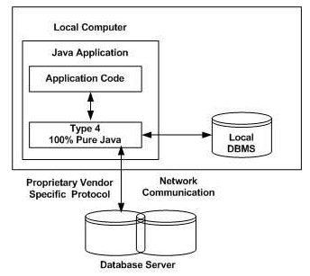
Networked DBMS
The most of DBMS make use of the TCP protocol for communicating with applications. They accept incoming connections on a specific TCP port. This allows both local and remote connections.
MS SQL Server (TCP:1433)
PostGreSQL (TCP:5432)
MySQL (TCP:3306)
Oracle (TCP:1521)
SQLite (local DB)

Slide 4
Local DB
There is also a family of libraries capable of simulating a DBMS connection while providing access to a local file using the SQL metaphor.
The most prominent example of this category is SQLite.
Widely used on the Android platform
https://developer.android.com/reference/android/database/sqlite/SQLiteDatabase

Slide 5
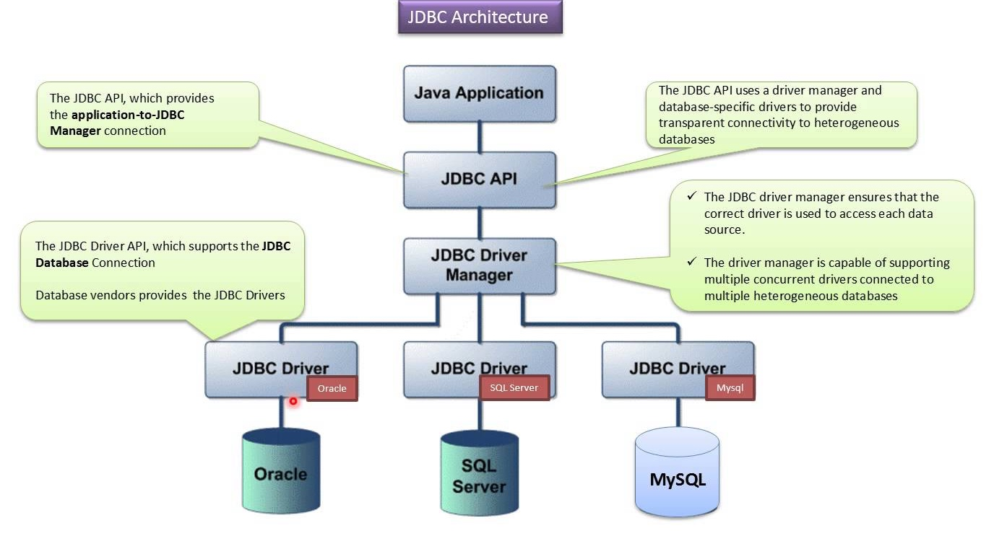
What is JDBC?
“An API that lets you access virtually any tabular data source from the Java programming language”
What’s an API? Application Programming Interface
What’s a tabular data source? Relational databases, spreadsheets, CSV files
We’ll focus on accessing relational databases. Nevertheless, the same principles can be applied to all data sources.

Slide 6
Basic steps
Load vendor specific Driver
Establish a Connection
Create a Statement
Execute SQL Statements
Get ResultSet
Close the Connection

Slide 7
Vendor specific drivers
JDBC drivers provide the connection to the database and implement the protocol for transferring queries and results between the client and the database.
There are 4 type of drivers. We refer to Type 4: Pure Java (see Appendix II)
Each database needs a specific driver.
[mySQL] https://dev.mysql.com/downloads/connector/j/
[SQLite] https://github.com/xerial/sqlite-jdbc
Drivers are Java binary classes (.class files) usually packaged in a single .jar archive and have to be included in the CLASSPATH

Slide 8
Vendor specific drivers
For including vendor specific drivers (or any external library) into the project, two main ways are possible:
Manually download a .jar file and add it to the CLASSPATH of the project (not a good idea!)
Configure a building tool (e.g., Maven, Gradle) to download it and make it available to the project
Gradle is the most recent tool and has been chosen as the default for Android Projects (build.gradle is the configuration file)

Slide 9
build.gradle
apply plugin: 'java-library' apply plugin: 'idea' group 'org.nbicocchi' version '1.0-SNAPSHOT' repositories { mavenCentral() } dependencies { testImplementation 'junit:junit:4.13' testImplementation 'com.openpojo:openpojo:0.8.13' implementation 'org.jetbrains:annotations:19.0.0' implementation 'joda-time:joda-time:2.10.6' implementation 'org.xerial:sqlite-jdbc:3.34.0' implementation 'mysql:mysql-connector-java:8.0.22' implementation 'com.microsoft.sqlserver:mssql-jdbc:9.2.1.jre15' implementation 'com.sparkjava:spark-core:2.5.5' implementation 'com.konghq:unirest-java:3.11.00' implementation 'com.sparkjava:spark-core:2.5.5' implementation 'com.fasterxml.jackson.core:jackson-core:2.11.3' implementation 'com.fasterxml.jackson.core:jackson-databind:2.11.3' implementation 'com.formdev:flatlaf:1.0' }

Slide 10
1. Load vendor specific driver
import java.sql.*;
/* this is for MySQL*/
Class.forName(“com.mysql.jdbc.Driver”);
/* this is for SQLite */
Class.forName(“org.sqlite.jdbc”);
JDBC is an abstract API mostly composed of interfaces and abstract classes. Concrete implementations are mostly provided within drivers.
Class.forname() dynamically loads the driver’s classes.
*throws ClassNotFoundException!

Slide 11
2. Establish a Connection (with URL)
DriverManager.getConnection(String url);
DriverManager.getConnection(String url,
String user,
String password);
DriverManager.getConnection(String url,
Properties prop);

Slide 12
2. Establish a Connection (with URL)
/* this is for MySQL*/
Connection c = DriverManager.getConnection(
“jdbc:mysql://localhost/dbname?user=user&password=pass”);
/* this is for SQLite */
Connection c = DriverManager.getConnection(
“jdbc:sqlite:filename.db”);
Establishes a connection to a database mediated by the Connection interface. The driver implements the Connection interface defined within JDBC

Slide 13
3. Create JDBC Statement(s)
Statement statement = c.createStatement() ;
The JDBC Statement, CallableStatement, and PreparedStatement interfaces define the methods and properties enabling developers to send SQL or PL/SQL commands and receive data from your database.
They also define methods helping bridge data type differences between Java and SQL data types used in a database.

Slide 14
4. Execute SQL Statements
Once you've created a Statement object, you can then use it to execute an SQL statement with one of its methods.
int executeUpdate (String SQL): Used for writing the database. Use this method to execute SQL statements such as INSERT, UPDATE, DELETE, CREATE TABLE, DROP TABLE, etc. Returns the number of rows affected by the execution of the SQL statement.
ResultSet executeQuery (String SQL): Used for reading the database. Use this method to execute SQL statements such as SELECT. Returns a ResultSet object.

Slide 15
4. Execute SQL Statements
statement.executeUpdate("CREATE TABLE person (" +
"_id INTEGER PRIMARY KEY AUTOINCREMENT, " +
"name VARCHAR(30), " +
"surname VARCHAR(30), " +
"salary REAL)");
statement.executeUpdate("INSERT INTO person (name, surname, salary) VALUES ('Chuck', 'Palahniuk’, 200.23)");
statement.executeQuery("SELECT * FROM person");
The String passed to the statement.execute* methods depends on the specific SQL dialect used by the database. It is SQL, not Java!

Slide 16
4. Execute SQL Statements
// Locales – among other things - influence the way in which strings are formatted
// Very nasty when creating SQL statements using string formatting
Locale locale = new Locale("en", "US");
// Locale locale = new Locale("it", "IT");
String sql = String.format(
"INSERT INTO person (name, surname, salary) VALUES ('%s', '%s', '%f')",
person.getName(),
person.getSurname(),
person.getSalary()
);
statement.executeUpdate(sql);
"INSERT INTO person (name, surname, salary) VALUES ('Mario', 'Rossi', '11.2')”
// "INSERT INTO person (name, surname, salary) VALUES ('Mario', 'Rossi', '11,2')"

Slide 17
4. Execute SQL Statements
// PreparedStatement provides an alternative to string formatting
// PreparedStatement also allows reuse with different paramenters (faster)
PreparedStatement insertPerson = connection.prepareStatement(
"INSERT INTO person (name, surname, salary) VALUES (?, ?, ?)");
for (Person person: persons) {
insertPerson.setString(1, person.getName());
insertPerson.setString(2, person.getSurname());
insertPerson.setDouble(3, person.getSalary());
insertPerson.execute();
}

Slide 18
5. Get ResultSet
The java.sql.ResultSet interface represents the result set of a database query. Objects implementing the ResultSet interface maintain a cursor pointing to the current row in the result set.
Navigational methods: Used to move the cursor around the ResultSet
Get methods: Used to view the data in the columns of the current row being pointed by the cursor.
Update methods: Used to update the data in the columns of the current row. Updates are transparently written within the underlying database (if supported)

Slide 19
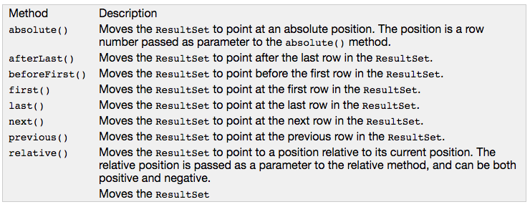
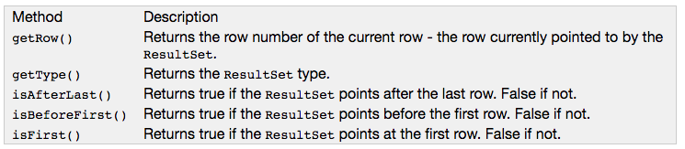
Navigational methods

Slide 20
Get methods
resultSet.getXXX(), where XXX is a primitive data type. Columns can be selected via either name or id.
rs.getString(“columnName”)
rs.getLong(“columnName”)
rs.getInt(“columnName”)
rs.getDouble(“columnName”)
rs.getString(1)
rs.getLong(2)
rs.getInt(3)
rs.getDouble(4)

Slide 21
Get methods
ResultSet rs = statement.executeQuery(
"SELECT * FROM person");
while(rs.next()) {
rs.getInt(“_id”);
rs.getString(“cf”);
rs.getString(“name”);
rs.getString(“surname”);
}
ResultSet rs = statement.executeQuery(
"SELECT * FROM person");
while(rs.next()) {
rs.getInt(1);
rs.getString(2);
rs.getString(3);
rs.getString(4);
}

Slide 22
Get methods
int idIndex = rs.findColumn(“_id”);
int cfIndex = rs.findColumn(“cf”);
int nameIndex = rs.findColumn(“name”);
int surnameIndex = rs.findColumn(“surname”);
while(rs.next()) {
int id = rs.getInt(idIndex);
String cf = rs.getString(cfIndex);
String name = rs.getString(nameIndex);
String surname = rs.getString(surnameIndex);
}
* If you need to access by column id but know only the column names

Slide 23
6. Close Connection
Programs should recover from errors and always leave the database in a consistent state. Runtime errors must be minimized in industrial applications!
If a statement throws an exception, it must be caught within a catch statement.
The finally {…} clause can be used to leave the database in a consistent state.
connection = null;
statement = null;
try {
. . .
} catch(SQLException e) {
// do something
} finally {
if (connection != null) {
statement.close();
connection.close();
}
}

Slide 24
Types
There are significant variations between the SQL types supported by different database products. For example, most of the major databases support an SQL data type for large binary values, but Oracle calls this type LONG RAW, Sybase calls it IMAGE and Informix calls it BYTE.
JDBC programmers mostly program with existing database tables, and they need not concern themselves with the exact SQL type names that were used.
The one major place where programmers may need to use SQL type names is in the SQL CREATE TABLE statement when they are creating a new database table. In this case programmers must take care to use SQL type names that are supported by their target database.

Slide 25
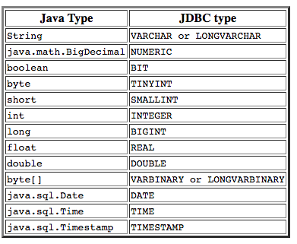
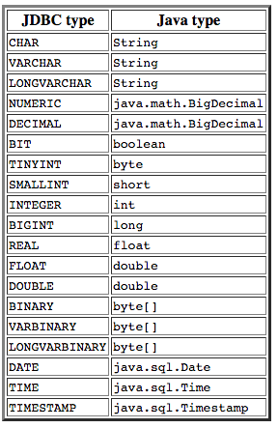
Mapping JDBC to Java types

Slide 26
Advanced ResultSet

Slide 27
Advanced ResultSet
ResultSet are iterator-like objects
With default ResultSets (TYPE_FORWARD_ONLY)
It is not possible to move back and forth with a default
Only next() can be called
It is not possible to modify the data with dedicated methods and, transparently, the database
Data have to be manipulated in memory and stored back with another operation (statement.executeUpdate())

Slide 28
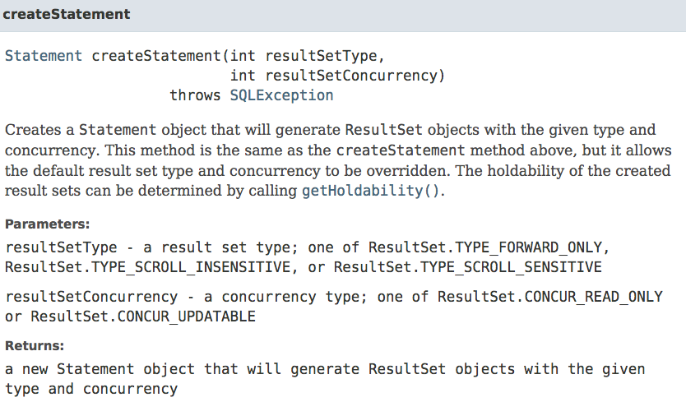
Advanced ResultSet

Slide 29
JDBC – Scrollable ResultSet
Statement s = c.createStatement(
ResultSet.TYPE_SCROLL_INSENSITIVE|ResultSet.TYPE_SCROLL_SENSITIVE,
ResultSet.CONCUR_READ_ONLY);
ResultSet rs = s.executeQuery(“SELECT * FROM person”);
rs.previous(); // go 1 record back
rs.relative(-5); // go 5 records back
rs.relative(7); // go 7 records forward
rs.absolute(100); // go to 100th record

Slide 30
JDBC – Updateable ResultSet
Statement s = c.createStatement(
ResultSet.TYPE_FORWARD_ONLY,
ResultSet.CONCUR_UPDATABLE);
ResultSet rs = s.executeQuery(“SELECT * FROM students WHERE type=‘listening’”);
while (rs.next()) {
int grade = rs.getInt(“grade”);
rs.updateInt(“grade”, grade + 1);
rs.updateRow();
}

Slide 31
Connection MetaData
A Connection object provides a DatabaseMetaData object which is able to provide schema information describing:
tables
supported SQL grammar
supported capabilities of the connection
stored procedures
* What is a stored procedure? A group of SQL statements forming a logical unit aimed at performing a specific task

Slide 32
Connection MetaData
// Establish Connection
Class.forName("org.sqlite.JDBC");
Connection connection = DriverManager.getConnection("jdbc:sqlite:sample.db");
// Get metadata
DatabaseMetaData md = connection.getMetaData();
// Verify ResultSet supported types
System.out.println("-- ResultSet Type --");
System.out.println("Supports TYPE_FORWARD_ONLY: ”
+ md.supportsResultSetType(ResultSet.TYPE_FORWARD_ONLY));
System.out.println("Supports TYPE_SCROLL_INSENSITIVE: ”
+ md.supportsResultSetType(ResultSet.TYPE_SCROLL_INSENSITIVE));
System.out.println("Supports TYPE_SCROLL_SENSITIVE: ”
+ md.supportsResultSetType(ResultSet.TYPE_SCROLL_SENSITIVE));

Slide 33
ResultSet MetaData
A ResultSet object provides a ResultSetMetaData object providing schema information
Useful for writing code running on different tables. For example, converting in JSON or XML the output of different queries.
public static void printRS(ResultSet rs) throws SQLException {
ResultSetMetaData md = rs.getMetaData();
// get number of columns
int nCols = md.getColumnCount();
// print column names
for(int i=1; i < nCols; ++i)
System.out.print(md.getColumnName(i) + ",");
}

Slide 34
Transactions

Slide 35
Definition
A transaction is a set of actions to be performed atomically. Either all of the actions are carried out, or none of them are.
The classic example of when transactions are necessary is the example of bank accounts. You need to transfer $100 from one account to the other. You do so by subtracting $100 from the first account and adding $100 to the second account. If this process fails after you have subtracted the $100 from the first bank account, the $100 is never added to the second bank account. The money is lost in cyberspace.

Slide 36
JDBC Transactions
JDBC allows SQL statements to be grouped together into a single transaction
Transaction control is performed by the Connection object, default mode is auto-commit, i.e., each sql statement is treated as a transaction
We can turn off the auto-commit mode with connection.setAutoCommit(false);
And turn it back on with connection.setAutoCommit(true);
Once auto-commit is off, no SQL statement will be committed until an explicit is invoked connection.commit(). At this point all changes done by the SQL statements will be made permanent in the database.

Slide 37
JDBC Transactions
Connection connection = ...
try{
connection.setAutoCommit(false);
// create and execute statements etc.
connection.commit();
} catch(Exception e) {
connection.rollback();
} finally {
if(connection != null) {
connection.close();
}
}

Slide 38
Appendix I: JDBC-ODBC

Slide 39
General Architecture
What happens if I need to use a rare DBMS which is not supported by JDBC? (e.g., no driver released) ? Use ODBC!
Open Database Connectivity (ODBC) is a standard application programming interface (API) for accessing database management systems (DBMS).
Released in 1992, it allows applications to be independent from database-specific details. Same goal as JDBC, released in 1997.

Slide 40
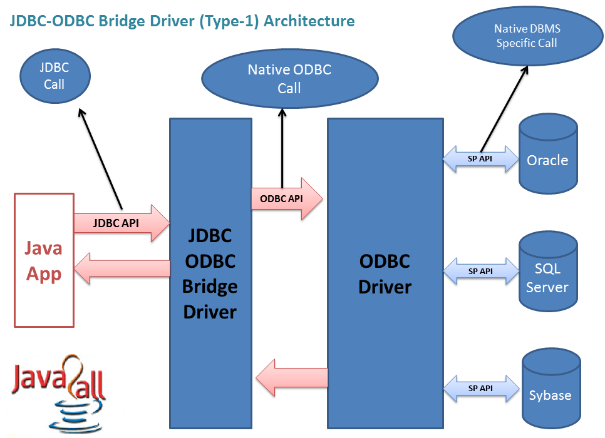
JDBC-ODBC

Slide 41
JDBC-ODBC
A JDBC-ODBC bridge consists of a JDBC driver which employs an ODBC driver to connect to a target database. This driver translates JDBC method calls into ODBC function calls. Programmers usually use such a bridge when a given database lacks a JDBC driver, but is accessible through an ODBC driver.
Vendors deliver JDBC-ODBC bridges which far outperform the JVM built-in (Removed from JVM since Java8).

Slide 42
APPENdiX II: Driver types

Slide 43
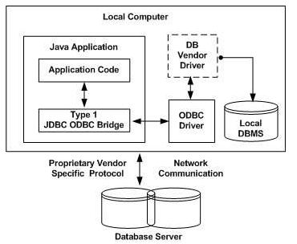
Type 1 JDBC Driver

Slide 44
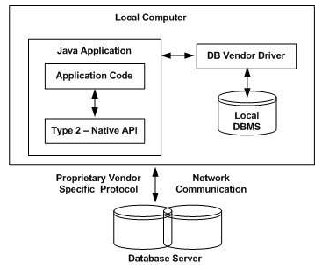
Type 2 JDBC Driver

Slide 45
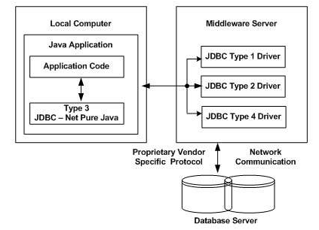
Type 3 JDBC Driver

Slide 46
Type 4 JDBC Driver

Slide 47
References
JDBC Data Access API – JDBC Technology Homepage
http://java.sun.com/products/jdbc/index.html
JDBC Database Access – The Java Tutorial
http://java.sun.com/docs/books/tutorial/jdbc/index.html
JDBC Documentation
http://java.sun.com/j2se/1.4.2/docs/guide/jdbc/index.html
java.sql package
http://java.sun.com/j2se/1.4.2/docs/api/java/sql/package-summary.html
JDBC Technology Guide: Getting Started
http://java.sun.com/j2se/1.4.2/docs/guide/jdbc/getstart/GettingStartedTOC.fm.html
JDBC API Tutorial and Reference (book)
http://java.sun.com/docs/books/jdbc/

